Slide 1
BEST PRACTICES IN CBA ASSESSMENT
Lois Olson
Amy Randel
George Easton
Nik Varaiya
John Anderson

Slide 2
College-Level Program Assessment
BSBA (Common Goals)
MBA
Department-Level Program Assessment
Undergraduate:
ACC, FIN, FIN SVC, IS, MGT, MGT-ENT, MGT-HR, MKT, MKT-IMC, RE
Graduate:
MSA, MSBA
Course-Level Assessment
College of Business Administration

Slide 3
MARKETING DEPARTMENT
Evaluating Individual Students in a Group Project Class

Slide 4
Evaluating Individual Students in a Group Project Class
Goal 5: Understand how to develop and evaluate strategic and tactical IMC plans and programs and assess communications effectiveness.
5.1 Analyze IMC strategies and plans that include various promotional mix elements including: advertising, public relations, sales promotion, direct marketing, the Internet, and interactive methods.
5.2 Analyze an IMC plan.

Slide 5
Evaluating Individual Students in a Group Project Class
Videotape an IMC class presentation
Instructor evaluates the presentation using rubric

Slide 6
Evaluation Rubric Developed
 | Below Expectations (1-2 Pts) | Meets Expectations (3-4 Pts) | Exceeds Expectations (5-6 Pts) | POINTS
Situation Analysis | Aspects of background or relevant external environment variables not discussed. Research is not thorough or is missing completely. Identified target market(s) do not follow clearly from any research presented. | Provides analysis of all relevant background including competition and external environment. Some research undertaken to support analysis. Target market(s) identified. Could be clearer how research led to target market. | Background is comprehensively examined and assessed. Competition, external environment, and any other relevant issues thoroughly researched and discussed. Research clearly supports target market(s) choice.
Objectives | Communication objectives do not flow clearly from situation analysis. One or more objective may be difficult to measure, vague, and/or not clearly distinct from Marketing objectives. | Complete communication objectives presented and follow reasonably well from situation analysis. Comm objectives are generally measurable and are distinguished from Marketing objectives. | Communication objectives are clearly stated and flow fully and naturally from results of situation analysis. Objectives are specific, distinct from Marketing objectives, and measurable.
Message Strategy | Basis of positioning is either missing or not presented clearly. If positioning is discussed, not clear what the connection between it and message strategy are. | Message strategy is presented and positioning discussed but relationship between positioning platform and message strategy may not be totally clear. | Message strategy is clearly presented and positions the product effectively. Positioning platform well-thought through and relationship between positioning and message are clear.
Media Strategy | Important elements of media strategy may be missing. No clear connection between media & message strategies. | Media strategy is presented and explained. Media strategy is reasonably consistent with message strategy. | Media strategy is clearly presented. Media strategy supports and enhances message.
Other Plan Elements | IMC plan omits one or more additional element that would contribute effectively. Appropriate public relations, direct marketing, Internet, sales promotion or support media are missing. | IMC plan includes some additional elements that are appropriate. May include public relations, direct marketing, Internet, sales promotion or support media. | IMC plan includes all additional elements that are appropriate (public relations, direct marketing, Internet, sales promotion, support media). Additional elements are clearly blended into positioning/message strategy.
Integration | Lack of consistent message across two or more elements causes understanding of IMC to be questioned. | Elements of IMC plan illustrate reasonable consistency and demonstrate understanding of the concept of IMC. | The concept of IMC is clearly promoted and demonstrated through the consistent message woven throughout plan elements.
Budget | Budget fails to clearly account for all plan items, does not support objectives, or is missing altogether. | Full budget is presented and appears to support the plan’s objectives. All plan items accounted for in budget. | Budget carefully and fully details each plan element. Supports stated objectives and is reasonable given any existing constraints.
Effectiveness | Plan for measuring effectiveness of IMC plan is weak. Method choice questionable or plan is missing altogether. | Plan for measuring effectiveness is presented. Choice of methods is reasonable. | Measurement of all elements of IMC plan is clearly accounted for. Measurement methods are chosen/designed to produce clear results.

Slide 7
Evaluating Individual Students in a Group Project Class
Videotape an IMC class presentation
Instructor evaluates the presentation using rubric
Students view the presentation of previous IMC plan and the Plan itself
Students individually evaluate the IMC program using the same rubric

Slide 8
Evaluating Individual Students in a Group Project Class
Videotape an IMC class presentation
Instructor evaluates the presentation using rubric
Students view the presentation of previous IMC
Students individually evaluate the IMC program
Instructor can use individual student scores
Assessment purposes: evaluate entire class
strengths and weaknesses
Instructor closes loop with current class, in future terms emphasizing “weak” areas

Slide 9
Evaluating a Individual Students in a Group Project Class
Videotape an IMC class presentation
Instructor evaluates the presentation using rubric
Students view the presentation of previous IMC
Students individually evaluate the IMC program
Instructor can use individual student scores
Assessment purposes: evaluate entire class
strengths and weaknesses
Instructor closes loop with current class
in future terms emphasizing “weak” areas

Slide 10
MANAGEMENT DEPARTMENT
Closing the Loop Practices in the Management Department

Slide 11
Closing the Loop Practices in the Management Department
Before Fall 2010:
Presented data to the department assessment committee and at department meetings and asked for suggestions for improvement
Fall 2010 to the present:
Divided the department into subgroups based on the areas represented by goals in our department assessment plan
Subgroups discussed and planned closing the loop activities specific to their area

Slide 12
Examples of Planned Closing the Loop Activities - Management Dept.
HR: Legislative act barring discrimination in HR
More time could be spent discussing Title VII in terms of the protected groups and protected activities covered by this law. In addition, more discussion could focus on differentiating this law from other equal employment opportunity laws.
OB: Describe and apply leadership theories
- Look for mini-cases and video simulations on leadership to use in class and for assignments. Options will be provided to instructors to consider for classroom use.

Slide 13
Information & Decision Systems DEPARTMENT
Continual Improvement in Assessment

Slide 14
What progress have we made in Assessing our programs?
Year | SDSU SLO Committee Feedback
2007 | (BSBA Oriented) - “We encourage you to rethink actions verbs in your SLOs. - “Develop timeline for complete program assessment” - “Consider re-integrating your Advisory Board Survey into your revised Assessment Plan”
IDS Department Loop Closing
*All-day retreat to review all aspects of our programs and curricula. developed/revised program mission, goals, and objectives; refined student learning outcomes -developed assessment schedule *surveyed Advisory Board
Year | SDSU SLO Committee Feedback
2008 | (MSBA in IS Oriented) - “We encourage you to move forward with implementation of the survey and analysis of results.”
IDS Department Loop Closing
*Began systematic assessment of MSBA *Surveyed MSBA alumni for feedback

Slide 15
What progress have we made in Assessing our programs?
Year | SDSU SLO Committee Feedback
2009 | “Pleased with substantial improvement in both BSBA and MSBA but… - “develop pool of questions that will be randomly selected for assessment of program goals within courses” - “develop improved rubrics so both instructors and students will understand the scale”
IDS Department Loop Closing
*Improved descriptors on rubrics to more clearly enunciate levels of achievement *Unable to develop pool of questions in time for 2010 assessment cycle. This item is highest on our priorities to address related to our assessment activities.
Year | SDSU SLO Committee Feedback
2010 | “Pleased with the improved rubrics but get to work on the pool of questions !”
IDS Department Loop Closing
*This will be addressed at next faculty curriculum/assessment meeting

Slide 16
FINANCE DEPARTMENT
Closing the Loop ON Global Issues in the Finance Department

Slide 17
Where were finance majors getting international finance content?
Coverage in FIN 323 less than needed due to time constraints
Department-level program learning outcomes not being achieved.
SOLUTION: FIN 329 (International Business Finance) becomes a required course for all BSBA Finance majors.

Slide 18
School of Accountancy
Development of Revised Goals, Student Learning Outcomes, and Mapping for M.S. in Accountancy
2010-2011

Slide 19
Assessment Analysis
Student Learning Outcome | Prior SLO and Assessment | Measurement Instrument | Possible Courses
SLO 1: Communication Skills | Combines 2.1, 2.2, 2.3 Assessment via 790 portfolio 2.1: 2006-07 2.2: 2006-07/2009-10 2.3: 2007-08 | Oral or written communication assignment | 659 (Gill) 670 675 681 790
SLO 2: Group/ Interpersonal Skills | No prior SLO | Peer Evaluations for: Group project/ case Group quizzes | 650 651 675 790
SLO 3: Ethics | SLO 3.1 Assessment via Accounting Ethical Dilemma Instrument in 790 | Project/Case Exam questions | Any course numbered 650 or higher

Slide 20
Assessment Analysis
SLO | Prior SLO and Last Assessment | Measurement instrument | Possible Courses
SLO 4: Research | SLO 3.2: 2009-10 Assessment via 790 Portfolio | Research memo/report | 650 (Tax) 659 (Tax/Fin) 660 (Fin) 663 (Fin) 790 (Academic
SLO 5: Problem Solving/Critical Thinking/ Technical Competence | No prior SLO | Project/case Comprehensive written exam question | 651 (Tax) 654 (Tax) 659 (Tax/Fin) 663 (Fin) 670 (Fin) 675 (Systems) 681 (Managerial)
SLO 6: Global/ International | No prior SLO | Written assignment Exam questions | 659 (MacKenzie) 661 681 790

Slide 21
Goals and Learning Outcomes for MS Accountancy
Goal 1: Communication Skills
Desired Bloom’s Taxonomy level: Analysis (4)
SLO 1: Students will be able to compare, contrast, interpret, or criticize accounting and business decisions and information using professional business communication.
Goal 2: Group/Interpersonal Skills
Desired Bloom’s Taxonomy level: Application (3)
SLO 2: Students will be able to actively participate in team decision making. Skills that represent active participation include interpersonal skills, motivation, attitude, and meaningful contributions to team decision making.
Goal 3: Ethics
Desired Bloom’s Taxonomy level: Analysis (4)
SLO 3: Students will be able to apply ethical judgment and professional standards in analyzing situations and formulating accounting and business decisions.

Slide 22
Goals and Learning Outcomes for MS Accountancy
Goal 4: Research
Desired Bloom’s Taxonomy level: Analysis (4)
SLO 4: Students will be able to use relevant research tools and academic/professional literature to analyze or take a position in accounting and business situations.
Goal 5: Problem Solving/Critical Thinking/Technical Competence
Desired Bloom’s Taxonomy level: Synthesis (5)
SLO 5: Students will be able to address unstructured problems in the areas of accounting information systems, financial reporting, or taxation. Unstructured problem solving involves using discipline-specific technical knowledge and skills to anticipate issues, formulate hypotheses, develop conclusions, or recognize the strategic role of accounting in business organizations and society.
Goal 6: Global/International
Desired Bloom’s Taxonomy level: Comprehension (2)
SLO 6: Students will be able to comprehend an international perspective and appreciate the significance of diversity and cultural differences in the global business environment.

Slide 23
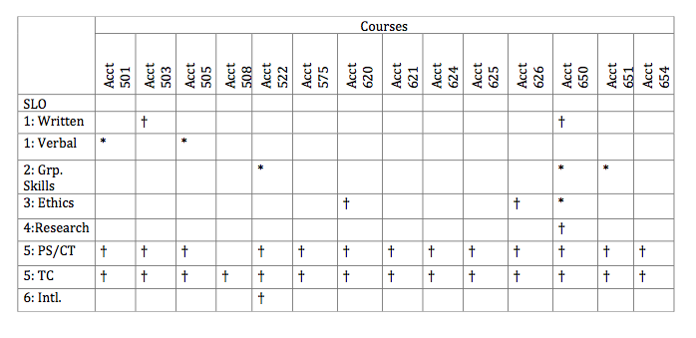
MSA Curriculum Map

Slide 24
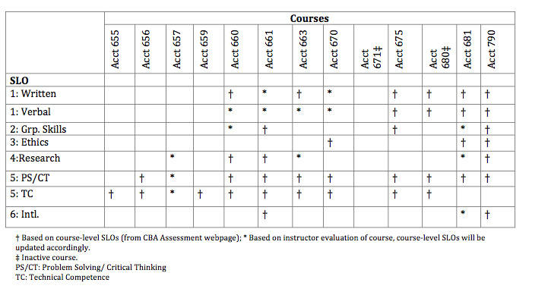
MSA Curriculum Map
† Based on course-level SLOs (from CBA Assessment webpage);
* Based on instructor evaluation of course, course-level SLOs will be updated accordingly.
‡ Inactive course.
PS/CT: Problem Solving/ Critical Thinking; TC: Technical Competence

